Slide 1
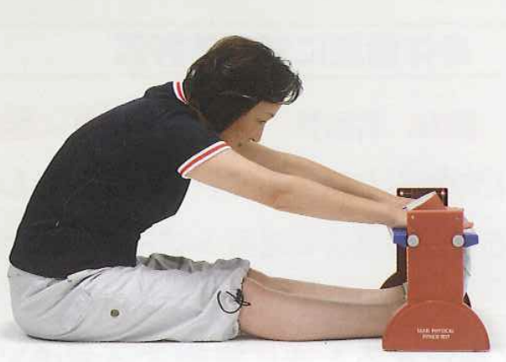
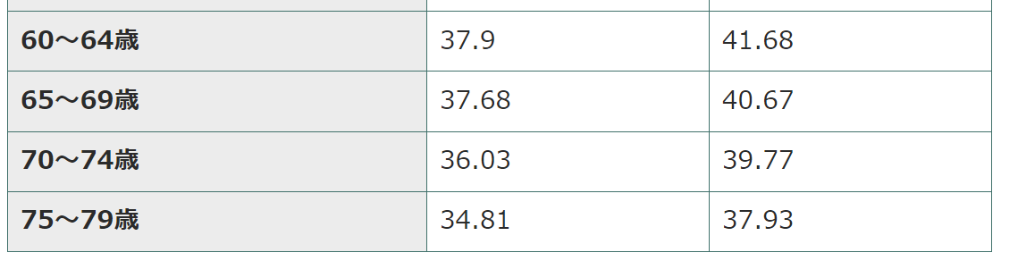
IV. Motor function measurement Physical performance measurements
Note: If painful, do not force yourself.
① 長座位体前屈
（ちょうざいたいぜんくつ）
Seated forward bend stretch (flexibility)
Note: Check with your instructor if your blood pressure is too high.
1. Purpose
Know your degree of flexibility. Mainly gluteus maximus, gastrocnemius, back of thigh (hamstring) and lumbar flexibility.
*Although measurements can be taken while standing and bending forward, middle-aged and elderly people are at risk of cerebrovascular accidents, etc., and may fall, so it is safer than standing. Long seated forward bending is considered and widely practiced.
2. Assessment and advice on life improvement
Decreased flexibility is highly correlated with the risk of injuries such as back pain and knee pain. If the flexibility of the lower limbs is low, the range of motion of the joints becomes narrow, leading to a decrease in activity in daily life, such as the inability to walk with long strides and the tendency to fall. effective stretching 。
Male Female （cm）
参照：https://www.tyojyu.or.jp/net/kenkou-tyoju/tairyoku-kiki/suichoku-tobi-sokutei.html

Slide 2
IV. 運動機能計測 Physical performance measurements
① 長座位体前屈（ちょうざいたいぜんくつ）
Seated forward bend stretch (flexibility)
Caution: If it hurts, do not force it.
Note: If your blood pressure is too high, check with your doctor.
3. Procedure and notes
(1) Initial posture: Subjects straighten their backs and place their backs and buttocks against the wall.
*The ankle angle is not fixed.
②While maintaining the initial posture, extend the arm forward so that the area around the center of the palm is
Install the measuring device so that it comes to the cursor (0 point).
③ Confirm that the cursor is at the 0 point.
(4) The subject slowly bends forward and straightens without letting go of the cursor.
"Slide forward as far as possible."
*At this time, be careful not to bend your knees or rotate your hip joints outward.
⑤ After bending forward to the maximum, return the upper body and release the cursor.
⑥ Perform the measurement twice. *The second time, tell them, "Let's try a little harder."

Slide 3
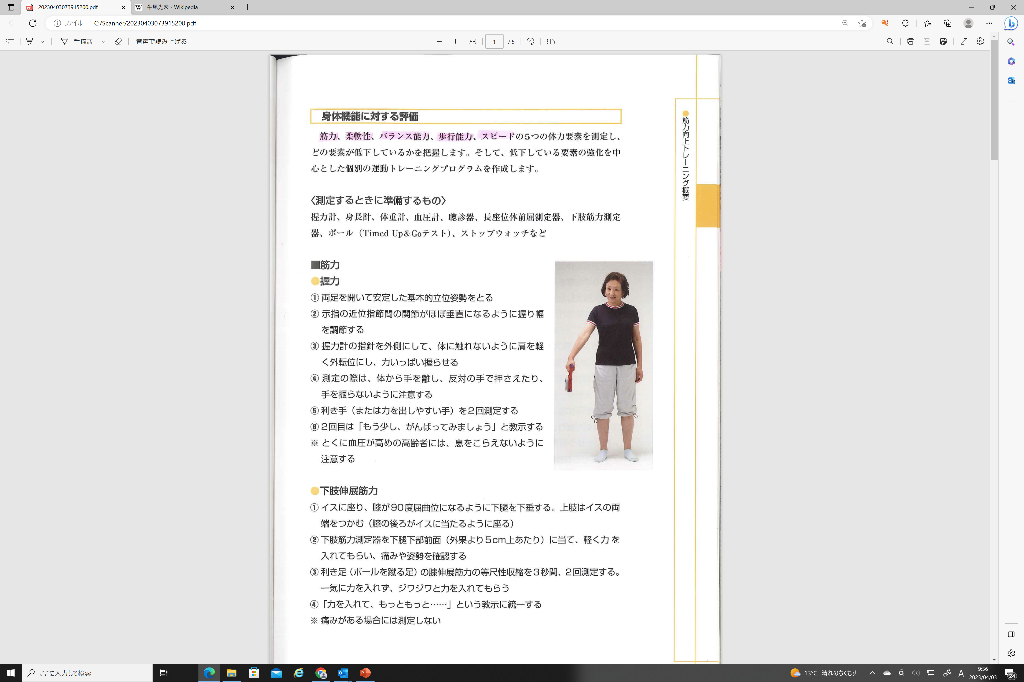
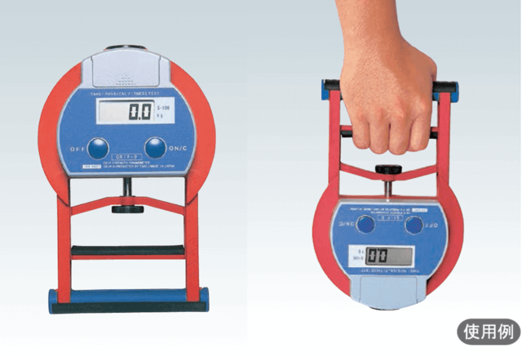
IV. 運動機能計測 Physical performance measurements
② 握力 Grip of hand
(strength)
Note: Check with your instructor if your blood pressure is too high.
1. Purpose
The force exerted when grasping an object, primarily due to the muscles of the forearm and upper arm. Although primarily a measure of upper body strength, many studies have shown that grip strength is associated with total body strength and disease risk.
2. Assessment and advice on life improvement
Mean value of grip strength of middle-aged and elderly people over 60 years old
60-64 years old Male 42.85kg Female 26.31kg
65-69 years old male 39.98kg female 25.20kg
70-74 years old male 37.36kg female 23.82kg
75-79 years old Male 35.07kg Female 22.49kg
Strength training is effective in increasing grip strength. Since grip strength is the power to grasp, it can be expected to increase naturally by exercising with weights.
参照：https://www.tyojyu.or.jp/net/kenkou-tyoju/tairyoku-kiki/kinryoku.html

Slide 4
IV. 運動機能計測 Physical performance measurements
Note: If your blood pressure is too high, check with your doctor.
② 握力 Grip of hand
(strength)
3. Procedure and notes
(1) Initial posture: Open both legs and take a stable basic standing posture as shown in the left figure.
② Grasp the joint between the proximal phalanges of the index finger of the dominant hand so that it is almost vertical, and adjust the width.
(3) Point the needle (display part) of the grip strength meter outward and have the patient grasp it with all their strength.
* Talk from the side of the body and hold it so as not to touch the side of the body.
(4) Measure the dominant hand (or the hand that tends to generate force) twice.
*The second time, tell them, "Let's try a little harder."

Slide 5
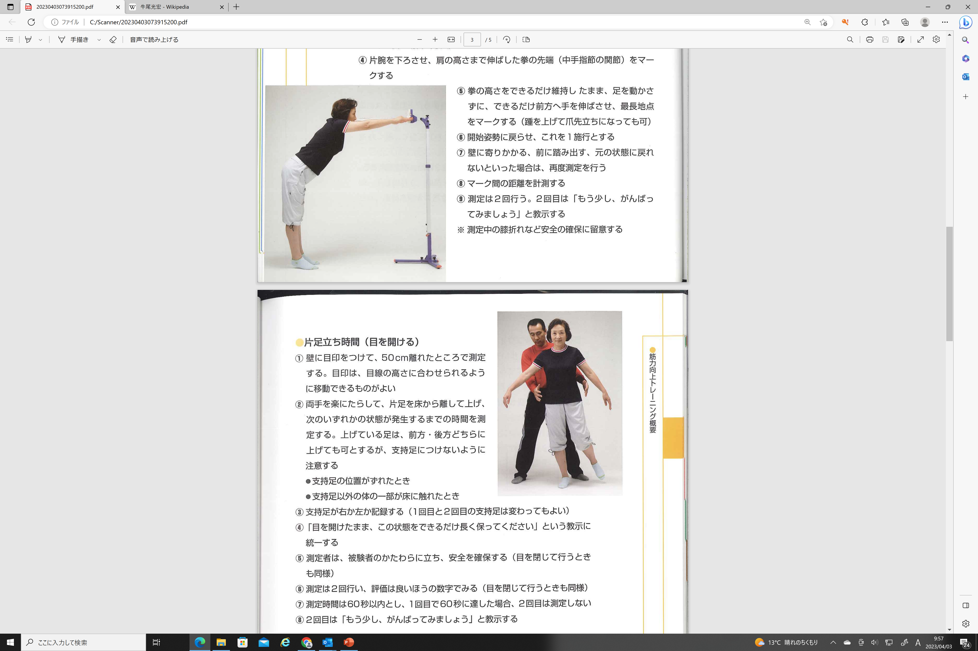
IV. 運動機能計測 Physical performance measurements
③ ファンクショナル・リーチ・テスト （バランス能力）
Functional reach test (balance)
Caution: If your blood pressure is too high, check with your teacher.
*There is a risk of falling. Avoid the danger.
1. Purpose
It measures the balance of the standing position, and evaluates the functional balance of how far you can respond by moving to break your balance.
2. Evaluation
The average measured value is 25 to 30 cm, and if the reach is 30 cm or more, the risk of falling is low.
If it is less than 20 cm, it is very easy to lose balance and is in a dangerous state.
There is a risk of falling at 20-25cm
[FRT evaluation cutoff value]
For frail elderly, "less than 18.5 cm" has a high fall risk
For stroke hemiplegic patients, "less than 15 cm" has a high fall risk
For Parkinson's disease patients, "less than 31.75 cm" has a high fall risk high risk
Reference: Rehab Cloud

Slide 6
IV. 運動機能計測 Physical performance measurements
③ ファンクショナル・リーチ・テスト（バランス能力）
Functional reach test (balance)
Caution: If your blood pressure is too high, check with your teacher.
*There is a risk of falling. Avoid the danger.
3. Procedure and notes
(1) Initial posture: Stand sideways facing the wall, spread both legs, and assume a stable basic standing posture. The line connecting the acromion, greater trochanter (lumbar joint), and lateral malleolus (ankle) stands perpendicular to the floor.
(2) Hold hands lightly, raise both arms to shoulder height, and be careful not to rotate the trunk. * When using the device as shown on the left, extend the fingers of both hands.
③ Lower one arm and mark the tip of the fist (metacarpophalangeal joint) extended to shoulder height.
(4) While maintaining the height of the fist as much as possible, extend the hand as far forward as possible without moving the leg to mark the longest point. *You can raise your heels and stand on your toes, but be careful not to fall.
⑤Return to the starting posture, and this is the first time. Lean against the wall, step forward, and if you can't return to the original state, measure again.
⑥ Perform the measurement twice. The second time, tell them, "Let's try a little harder."

Slide 7
IV. 運動機能計測 Physical performance measurements
④ 片足立ち時間（目を開ける）
Standing on one leg with eye open
(Equilibrium ability)
Caution: There is a risk of falling. Avoid the danger.
Caution: Time will be measured, so please work in pairs.
A stopwatch is required.
1. Purpose
An evaluation method for examining leg muscle strength and balance function. The evaluation of standing on one leg is one of the functional evaluation criteria for diagnosing "musculoskeletal instability symptoms" along with the TUG evaluation by the Japanese Orthopedic Association.
2. Evaluation
The risk of locomotor instability increases in ``less than 15 seconds'' when standing on one leg with eyes open
Standing on one leg with eyes closed for 5 seconds or less, standing on one leg with eyes open for 20 seconds or less increases risk of falling
Target value by age (reference value)
60s: 70 seconds
80s: 10 seconds
参照：https://rehab.cloud/mag/3573/
（参考文献：PTジャーナル 2009,9 高齢者の運動機能と理学療法）

Slide 8
IV. 運動機能計測 Physical performance measurements
④ 片足立ち時間（目を開ける）
Standing on one leg with eye open
(Equilibrium ability)
Caution: There is a risk of falling. Avoid the danger.
Caution: Time will be measured, so please work in pairs.
A stopwatch is required.
(1) Initial posture: The examinee is placed in a standing position at a distance of 50 cm with a mark on the wall according to the area of eye line. * Do not close your eyes. (2) The examinee should hang his or her hands comfortably. The supporter stands by from behind in case of a fall, as shown in the figure on the left. Tell them, "Keep your eyes open and keep one leg up for as long as possible." At the signal "Okay, start," ask the examinee to lift one foot off the floor and measure the time it takes for one of the following conditions to occur: The raised foot can be raised either forward or backward, but it should not be attached to the supporting foot. ● When the position of the support foot is shifted ● When a part of the body other than the supporting foot touches the floor (3) Record whether the supported foot is the right foot or the left foot (the first and second times do not have to be the same). (4) Measurement is performed twice. Let's look at the good numbers. The second time, tell them, "Let's try a little harder." * The measurement time should be within 60 seconds, and if the first measurement exceeds 60 seconds, the second measurement will not be performed.

Slide 9
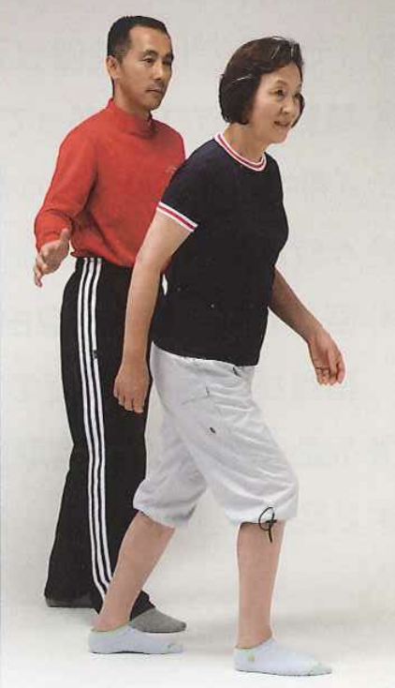
IV. 運動機能計測 Physical performance measurements
Caution: Risk of falling. Avoid danger.
A stopwatch is required.
⑤ 最大歩行能力 Walking speed
(ability to move)
1. Purpose
To be able to judge whether a person has the ability to move across a crosswalk. The speed at which a person can cross a crosswalk is said to be "1m/sec or faster."
2. Evaluation
In the 5m walking test, those who are slower than "5 seconds" are judged to be unable to cross the crosswalk.
Cut-off value
1. Unable to cross the crosswalk: 5 seconds or more (1.0 m/sec) (Muranaga Shingo, Motor Function and Physical Therapy in the Elderly, PT Journal, October 2009)
2. High risk of falling: 6.2 seconds or more (0.806 m/sec) (Otao Hiroshi, Predictors of Falls Over a Year in Elderly People Requiring Care, 50th Annual Meeting of the Japanese Physical Therapy Society)
参照：https://rehab.cloud/mag/3592/

Slide 10
IV. 運動機能計測 Physical performance measurements
Caution: Risk of falling. Avoid danger.
A stopwatch is required.
⑤ 最大歩行能力 Walking speed
(ability to move)
①Preparation: Secure a 3m reserve path and attach straight tape to the 5m measuring section of the walkway.
② Provide an explanation.
③ Measure the time it takes from when the waist or shoulders cross the tape at the beginning of the measurement section (3m point) to when the waist or shoulders cross the tape at the end of the measurement section (8m point).
④ Measure while staying next to the person to prevent them from falling. Measure without running.
⑤ Measure twice. On the second measurement, tell them, "Let's try a little harder." 。
予備区間
3ｍ
予備区間
3ｍ
測定区間
５ｍ

Slide 11
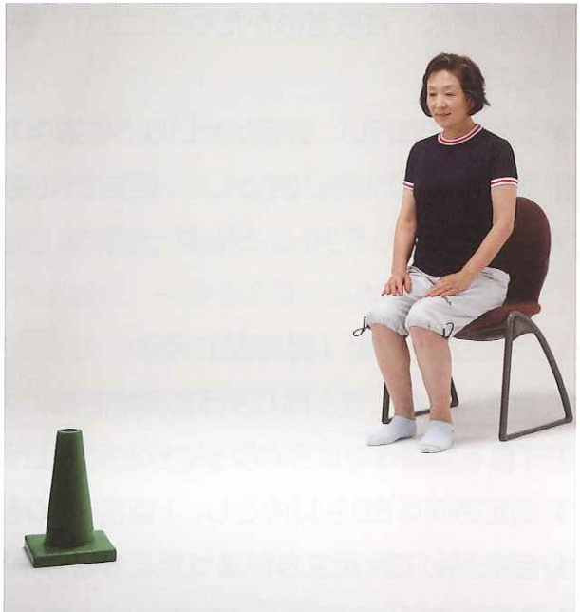
IV. Motor function measurementPhysical performance measurements
Caution: There is a risk of falling. Avoid danger.
Caution: Time will be measured, so staff should work in pairs.
Caution: If the subject is wearing slippers, please avoid this this time.
A stopwatch is required.
⑥Timed Up & Goテスト
(ability to move)
1. Purpose
The Timed Up & Go Test (TUG) is an indicator of musculoskeletal instability (MADS) along with the time to stand on one leg with eyes open. It is generally a useful test for determining the risk of falling. In particular, it is highly related to daily life functions such as lower limb strength, balance, walking ability, and tendency to fall, with regard to the motor function of the elderly.
2. Evaluation
Cutoff value
13.5 seconds or more: Risk of falling is predicted. 30 seconds or more: Assistance is required for daily living activities such as getting up and down.
Furthermore, the Japanese Orthopaedic Association has set the cutoff value of the TUG test at "11 seconds or more" as the standard for determining musculoskeletal instability.
Definition of musculoskeletal instability: A state in which balance and walking ability are reduced due to musculoskeletal diseases that cause motor function decline with aging, leading to isolation and an increased risk of falling (Japanese Orthopaedic Association)

Slide 12
IV. Motor function measurementPhysical performance measurements
Caution: There is a risk of falling. Avoid danger.
Caution: Time will be measured, so staff should work in pairs.
Caution: If the subject is wearing slippers, please avoid this this time.
A stopwatch is required.
⑥Timed Up & Goテスト
(ability to move)
① Initial position: The subject sits in the chair with their back against the backrest and their hands on their thighs.
② Instructions: "At the signal, set, go, tell the subject to 'turn around as fast as you can' at a comfortable and safe speed (be careful of falls), and measure the time it takes them to turn around the marker 3m away and sit back down on the chair.
*The start time is when their back leaves the chair, and the finish time is when their bottom touches the chair.
*Staff will accompany the subject as they walk to prevent them from falling.
③ At the signal, "set, go," the subject begins. They can go around the cones in any way they like.
④ The subject will practice the first time, and then the measurement will be taken twice. The better number will be taken. For the second time, tell them to 'try a little harder.'

